Slide 1
Who Am I?
Lominger Positive Competencies
Written Communications
Standing Alone
Listening
Lominger Negative Competencies
Hiring and Staffing
Sizing Up People
Self-Knowledge

Slide 2
My degree Program
Competencies Acquired
Testing
Architecture
Distributed System
How Is It Relatable?
Cloud dev
Architectural decisions

Slide 3




GEDYTE GMBH
Domain

Slide 4
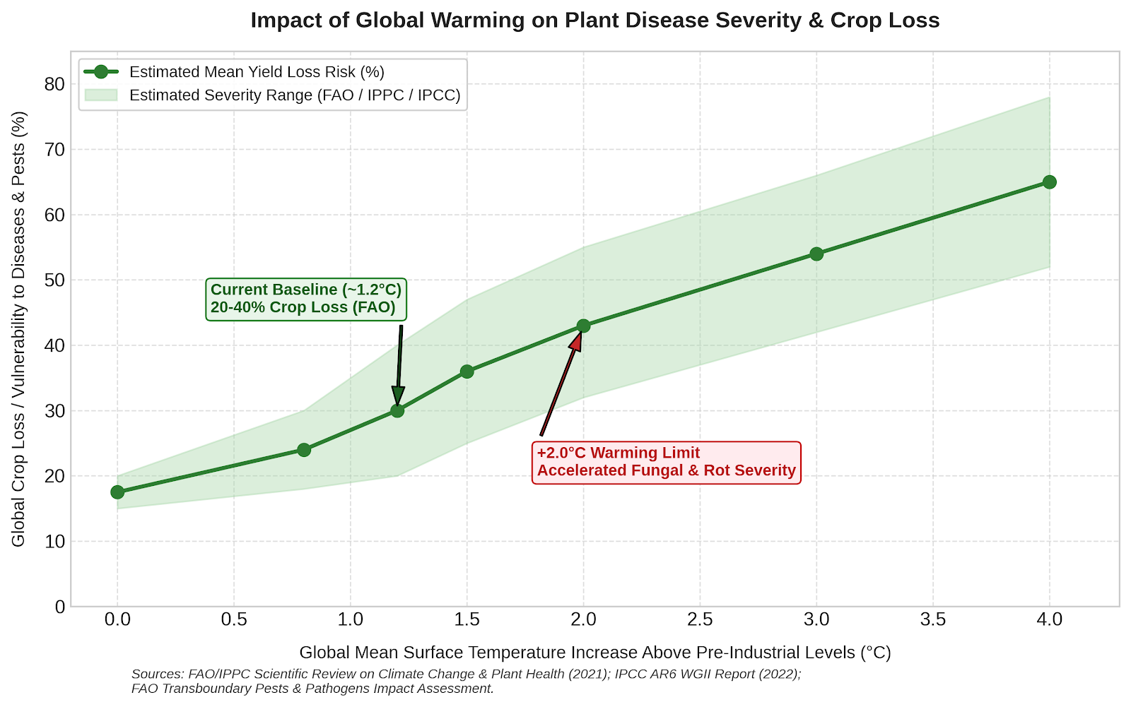
Why GEDYTE?
A Solution For Inevitable Problem
Flexibility & Growth
Communication Ease

Slide 5
General Info
Where?
Which brands does the company own?
Product Portfolio
AI based product
Used for optimizing small green houses
Research, testing, production these technologies

Slide 6
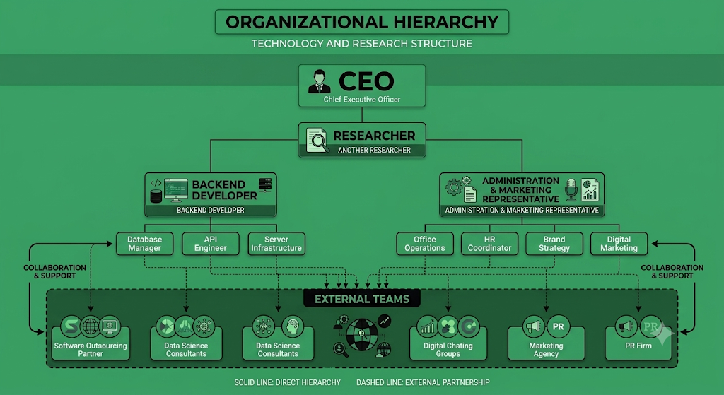
Continue General Info
How Many Employees
4-10
External Assistance
Ownership Structure

Slide 7
Thanks!

